Slide 1

WHILE WAITING
Isaiah 40:31
Sis. Liezel Gilva

Slide 2


I. Divine Exchange
Waiting is exchanging not losing.

Slide 3
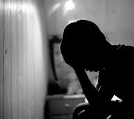
II. Never Neglect to Expect
Expecting is the sound of faith

Slide 4
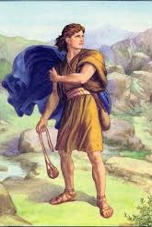
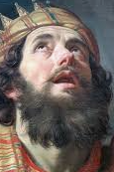
III. Waiting is preparing
"Character is built in waiting "

Slide 5
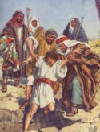
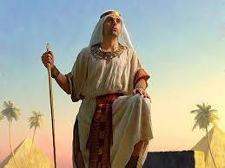
III. Waiting is preparing
"Character is built in waiting "

Slide 6

Conclusion
Your waiting is not a waste
it's a refining , be still,
stay focus
like an eagle

